Slide 1
Quantum Singular Value Transform
Sharan Krishnan

Slide 2
Outline
What is a singular value transformation
Quantum signal processing
Quantum Singular Value Transformation
Application to solving linear systems of equations

Slide 3
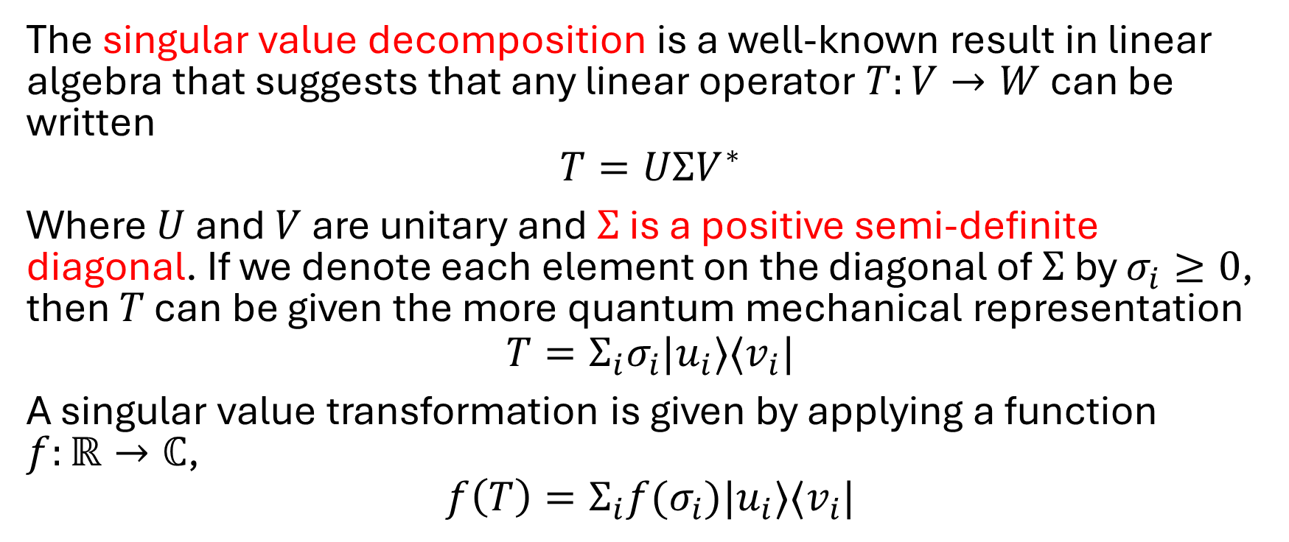
What is a singular value transformation?
The singular value decomposition is a well-known result in linear algebra that suggests that any linear operator $T:V→W$ can be written
$$T=UΣV^{∗}$$
Where $U$ and $V$ are unitary and $Σ$ is a positive semi-definite diagonal. If we denote each element on the diagonal of $Σ$ by $σ_{i}≥0$, then $T$ can be given the more quantum mechanical representation
$$T=Σ_{i}σ_{i}|u_{i}⟩⟨v_{i}|$$
A singular value transformation is given by applying a function $f:ℝ→ℂ$,
$$f\left(T\right)=Σ_{i}f(σ_{i})|u_{i}⟩⟨v_{i}|$$

Slide 4
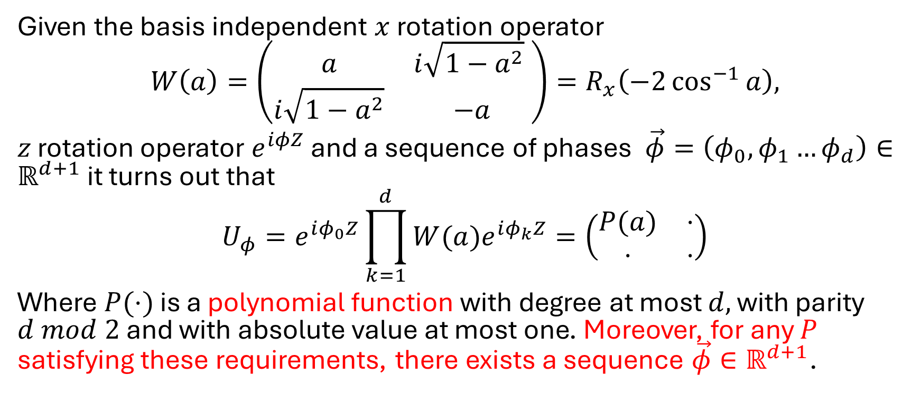
Quantum Signal Processing
Given the basis independent $x$ rotation operator
$$W\left(a\right)=\left(\begin{matrix}a & i\sqrt{1−a^{2}} \\ i\sqrt{1−a^{2}} & −a\end{matrix}\right)=R_{x}\left(−2\cos^{−1}{a}\right),$$
$z$ rotation operator $e^{iφZ}$ and a sequence of phases $\vec{φ}=\left(φ_{0},φ_{1}…φ_{d}\right)∈ℝ^{d+1}$ it turns out that
$$U_{φ}=e^{iφ_{0}Z}\prod_{k=1}^{d}{{W(a)e}^{iφ_{k}Z}}=\left(\begin{matrix}P(a) & ⋅ \\ ⋅ & ⋅\end{matrix}\right)$$
Where $P(⋅)$ is a polynomial function with degree at most $d,$ with parity $d mod 2$ and with absolute value at most one. Moreover, for any $P$ satisfying these requirements, there exists a sequence $\vec{φ}∈ℝ^{d+1}$.

Slide 5
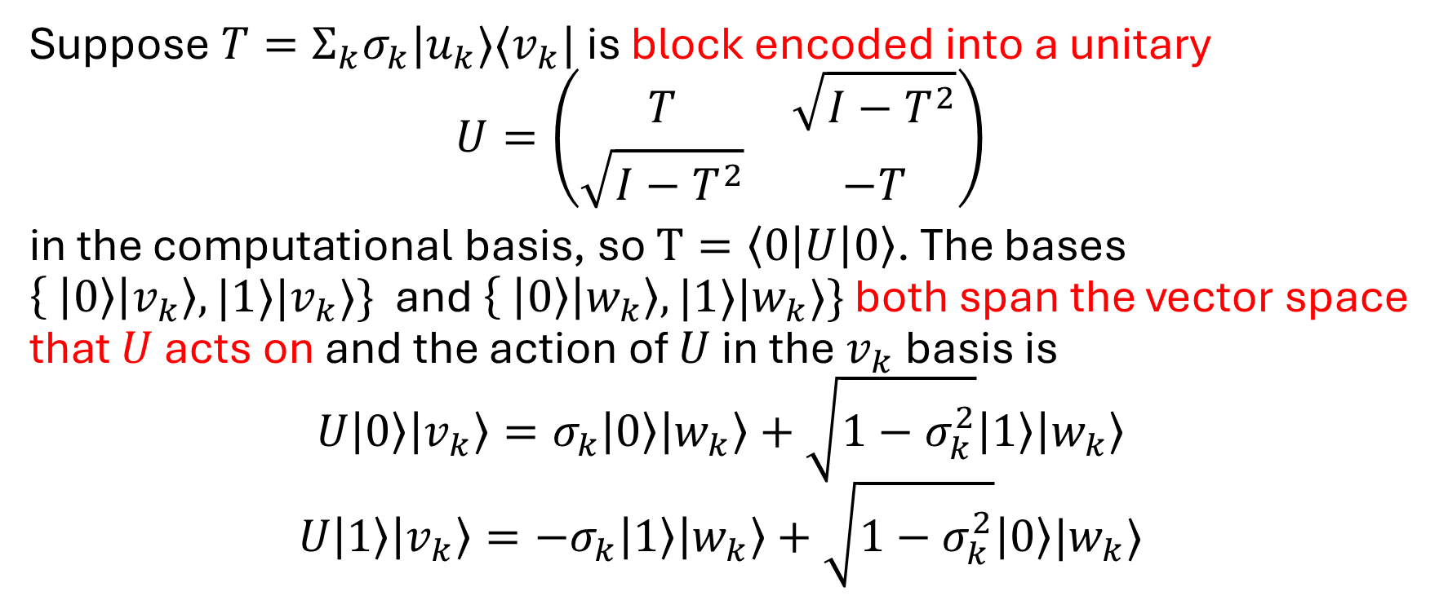
Quantum Singular Value Transform Part 1
Suppose $T=Σ_{k}σ_{k}|u_{k}⟩⟨v_{k}|$ is block encoded into a unitary
$$U=\left(\begin{matrix}T & \sqrt{I−T^{2}} \\ \sqrt{I−T^{2}} & −T\end{matrix}\right)$$
in the computational basis, so $T=\left\langle 0\left|U\right|0\right\rangle$. The bases $\left\{ | 0\right\rangle \left|v_{k}\right\rangle , |1⟩|v_{k}⟩\}$ and $\left\{ | 0\right\rangle \left|w_{k}\right\rangle , |1⟩|w_{k}⟩\}$ both span the vector space that $U$ acts on and the action of $U$ in the $v_{k}$ basis is
$$U\left|0\right\rangle \left|v_{k}\right\rangle =σ_{k}\left|0\right\rangle \left|w_{k}\right\rangle +\sqrt{1−σ_{k}^{2}}\left|1\right\rangle \left|w_{k}\right\rangle$$
$$U\left|1\right\rangle \left|v_{k}\right\rangle ={−σ}_{k}\left|1\right\rangle \left|w_{k}\right\rangle +\sqrt{1−σ_{k}^{2}}\left|0\right\rangle |w_{k}⟩$$

Slide 6
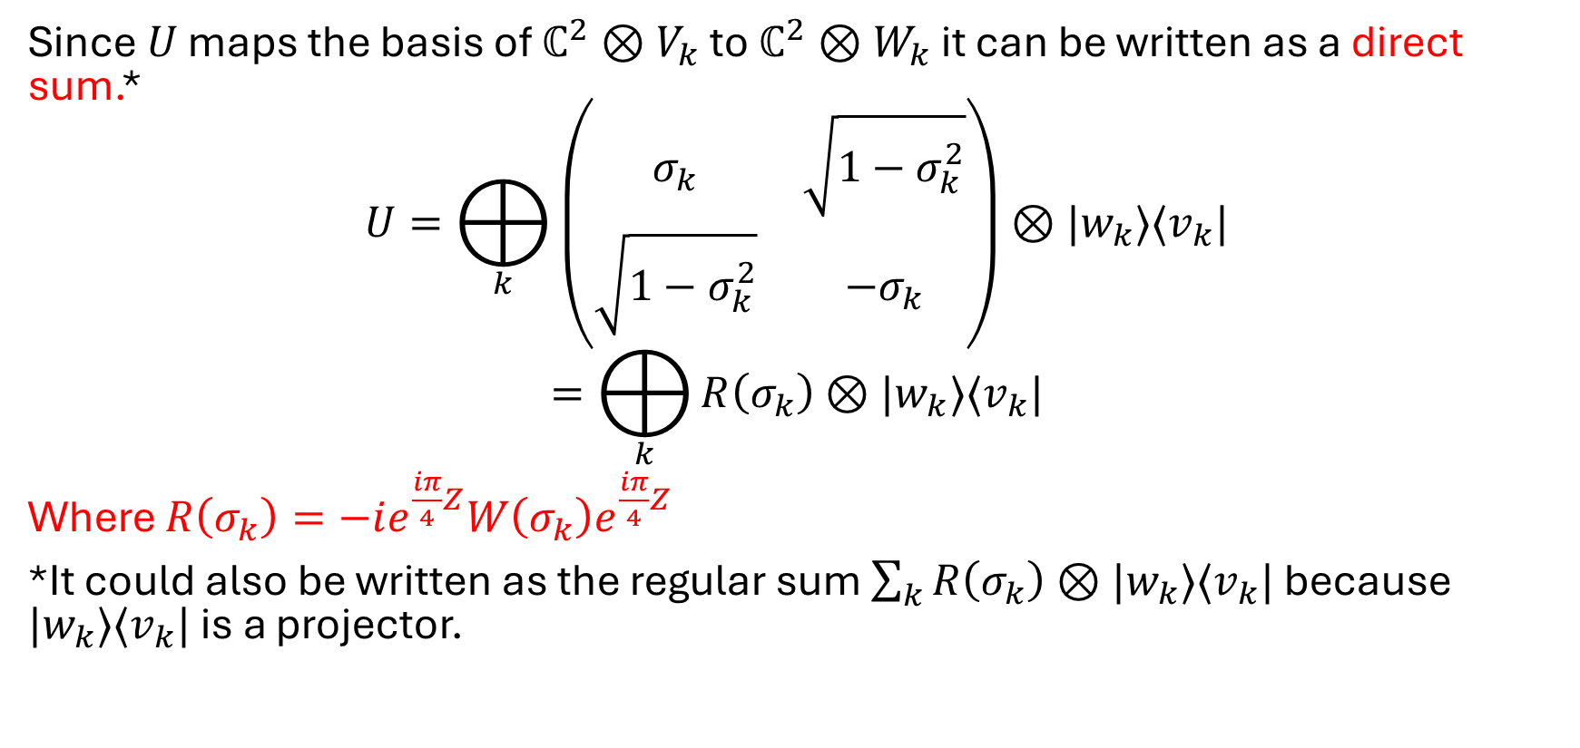
Quantum Singular Value Transform Part 2
Since $U$ maps the basis of $ℂ^{2}⊗V_{k}$ to $ℂ^{2}⊗W_{k}$ it can be written as a direct sum.*
$$U=⨁_{k}{\left(\begin{matrix}σ_{k} & \sqrt{1−σ_{k}^{2}} \\ \sqrt{1−σ_{k}^{2}} & −σ_{k}\end{matrix}\right)⊗|w_{k}⟩⟨v_{k}|}$$
$$=⨁_{k}{R\left(σ_{k}\right)⊗|w_{k}⟩⟨v_{k}|}$$
Where $R\left(σ_{k}\right)=−ie^{\frac{iπ}{4}Z}W\left(σ_{k}\right)e^{\frac{iπ}{4}Z}$
*It could also be written as the regular sum $\sum_{k}{R\left(σ_{k}\right)⊗|w_{k}⟩⟨v_{k}|}$ because $|w_{k}⟩⟨v_{k}|$ is a projector.

Slide 7
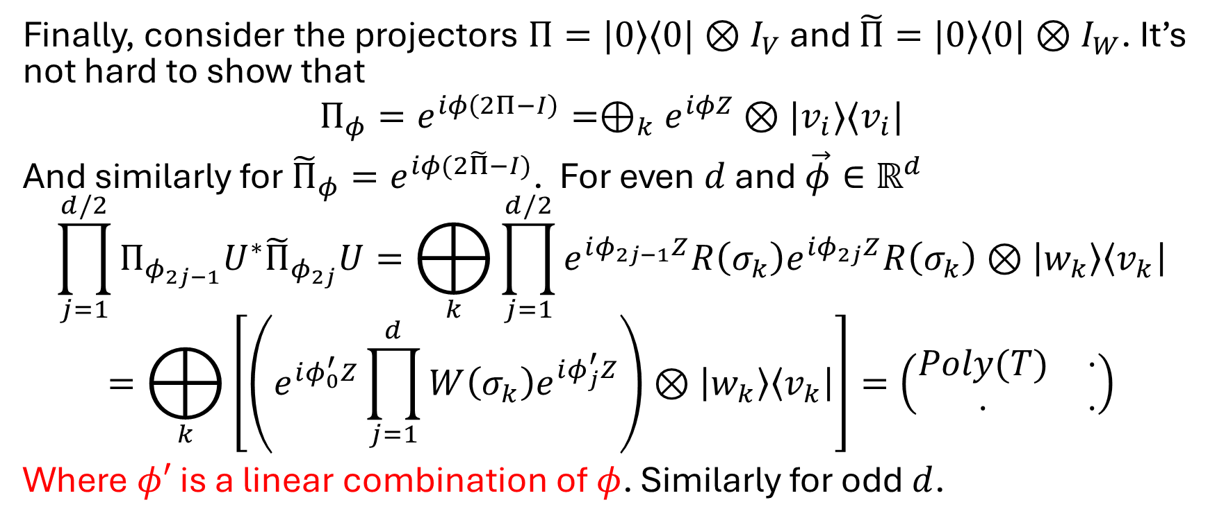
Quantum Singular Value Transform Part 3
Finally, consider the projectors $Π=|0⟩⟨0|⊗I_{V}$ and $\tilde{Π}=|0⟩⟨0|⊗I_{W}$. It’s not hard to show that
$${Π_{φ}=e}^{iφ\left(2Π−I\right)}=⊕_{k}e^{iφZ}⊗|v_{i}⟩⟨v_{i}|$$
And similarly for ${{\tilde{Π}}_{φ}=e}^{iφ(2\tilde{Π}−I)}$. For even $d$ and $\vec{φ}∈ℝ^{d}$
$$\prod_{j=1}^{d/2}{Π_{φ_{2j−1}}U^{∗}{\tilde{Π}}_{φ_{2j}}U}=⨁_{k}{\prod_{j=1}^{d/2}{e^{iφ_{2j−1}Z}R\left(σ_{k}\right)e^{iφ_{2j}Z}R\left(σ_{k}\right)⊗\left|w_{k}\right\rangle \left\langle v_{k}\right|}}$$
$$=⨁_{k}{\left[\left(e^{iφ_{0}^{′}Z}\prod_{j=1}^{d}{W\left(σ_{k}\right)e^{iφ_{j}^{′}Z}}\right)⊗\left|w_{k}\right\rangle \left\langle v_{k}\right|\right]=\left(\begin{matrix}Poly(T) & ⋅ \\ ⋅ & ⋅\end{matrix}\right)}$$
Where $φ′$ is a linear combination of $φ$. Similarly for odd $d$.

Slide 8
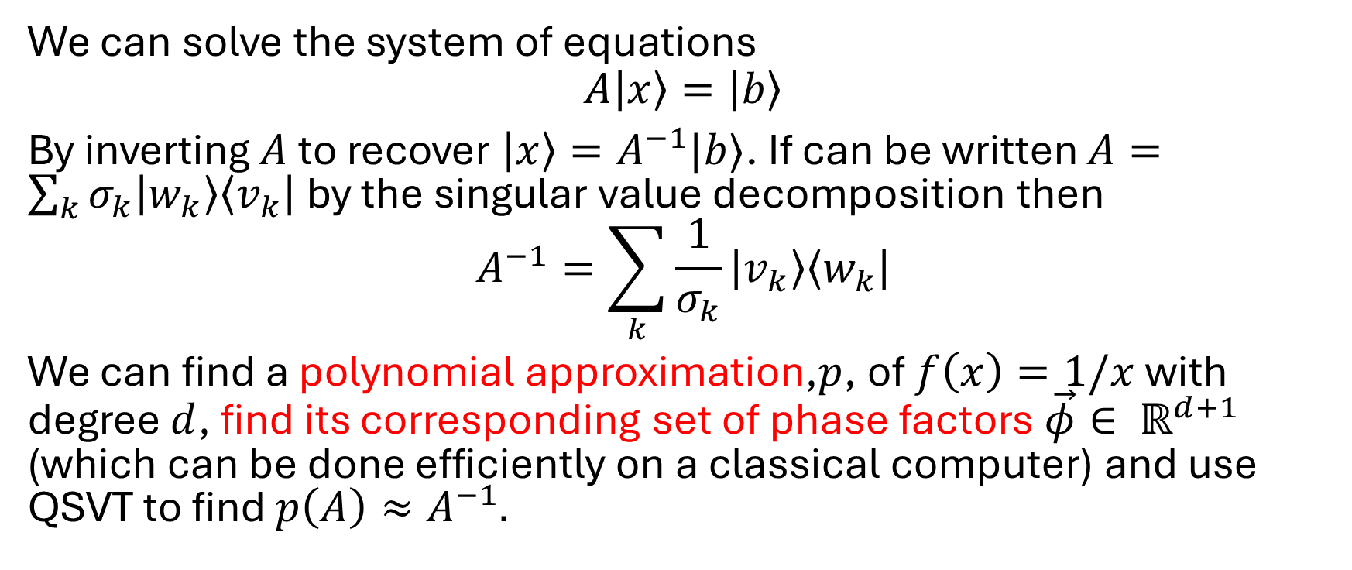
Application to solving linear equations
We can solve the system of equations
$$A\left|x\right\rangle =\left|b\right\rangle$$
By inverting $A$ to recover $\left|x\right\rangle =A^{−1}|b⟩$. If can be written $A=\sum_{k}{σ_{k}\left|w_{k}\right\rangle \left\langle v_{k}\right|}$ by the singular value decomposition then
$$A^{−1}=\sum_{k}{\frac{1}{σ_{k}}}\left|v_{k}\right\rangle \left\langle w_{k}\right|$$
We can find a polynomial approximation,$p$, of $f\left(x\right)=1/x$ with degree $d$, find its corresponding set of phase factors $\vec{φ}∈ ℝ^{d+1}$ (which can be done efficiently on a classical computer) and use QSVT to find $p\left(A\right)≈A^{−1}.$

Slide 9
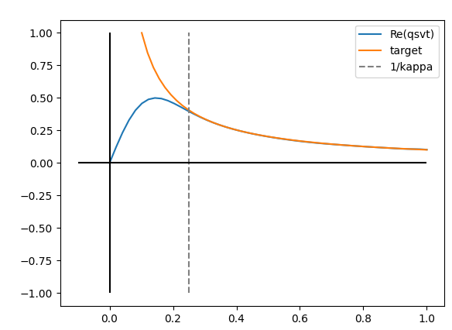
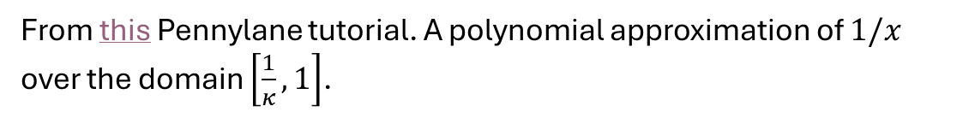
From this Pennylane tutorial. A polynomial approximation of $1/x$ over the domain $\left[\frac{1}{κ}, 1\right]$.

